Slide 1
Shutdown and Reboot
Version A.01
H3064S Module 17 Slides

Slide 2
HP-UX Operation States
Multi-user mode
Normal machine state
Users can log in
File systems mounted
Most services plus daemons available
Single-user mode
Required for some admin tasks
Only root login allowed
Non-critical file systems unmounted
Non-critical daemons shut down
Halt state
Nothing running
a66979

Slide 3
Changing State with Shutdown and Reboot
Multi-user Mode
shutdown
shutdown -h
Single-user Mode
shutdown -r
reboot -h
reboot
Halt State
Power-off
Power-off
a69710

Slide 4
System Boot Introduction
Goal
Load kernel in memory.
Bring system up to a fully functional state.
boot area
/
stand
vmunix
CPU
Memory
Boot Disk
SPU
a66981

Slide 5
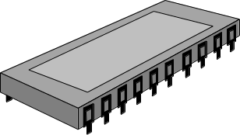
System Boot Players
BootROM
BootROM
Boot area
boot area
File system
containing the
kernel
/stand/vmunix
Stable
Storage
Stable storage
Primary swap
swap
Boot Disk
SPU
a66982

Slide 6
System Boot Process Overview
PDC
Test SPU.
Choose a boot disk using h/w paths in stable storage.
Load and run ISL utility from boot disk.
ISL
Read AUTO file from boot disk for kernel load options.
Load and run hpux utility from boot.
hpux
Find root file system on boot disk.
Load and run kernel from boot disk.
vmunix
Uses “init” to start all necessary daemons and services.
Bring system to multi-user mode.
a66983

Slide 7
Autoboot versus Manual Boot
Autoboot
System boots without admin intervention
Uses default boot disk kernel
Normal mode of operation
What if . . .
The primary boot disk is damaged?
The default kernel is unbootable?
The root password has been lost?
A manual boot may be required!
a66984

Slide 8
Initiating the Boot Sequence
From a power-off state
Hit the power switch!
From a running system
Multiuser mode: shutdown -r
Single-user mode: reboot
a66985

Slide 9
Interacting with the PDC/BootROM
Interrupting the autoboot
menu choice: a # some models go straight to BOOT_ADMIN
Useful PDC commands
BOOT_ADMIN> help # view help menu
BOOT_ADMIN> search # list all SCSI devices
BOOT_ADMIN> search ipl # list all possible boot devices
BOOT_ADMIN> path # list all boot paths in stable storage
BOOT_ADMIN> path pri scsi.6.0 # set scsi.6.0 as primary boot path
BOOT_ADMIN> path alt scsi.0.0 # set scsi.0.0 as alternate boot path
BOOT_ADMIN> boot alt # boot from the alternate boot path
BOOT_ADMIN> boot pri # boot from the primary boot path
BOOT_ADMIN> boot pri isl # boot from the primary to isl prompt
Power
Escape
a66986

Slide 10
Interacting with the ISL
Getting to the ISL
menu choice: a # some models go straight to BOOT_ADMIN
BOOT_admin> boot pri isl # use “isl”
Interact with IPL? Yes # some models go straight to ISL
Useful ISL commands
ISL> help # list available commands
ISL> hpux # boot from default kernel
ISL> hpux -is # boot to single-user mode
ISL> hpux ls # list contents of /stand
ISL> hpux -is /stand/vmunix.prev # boot using an alternate kernel
ISL> hpux show autofile # show the LIF AUTO file contents
Power
Escape
a66987

Slide 11
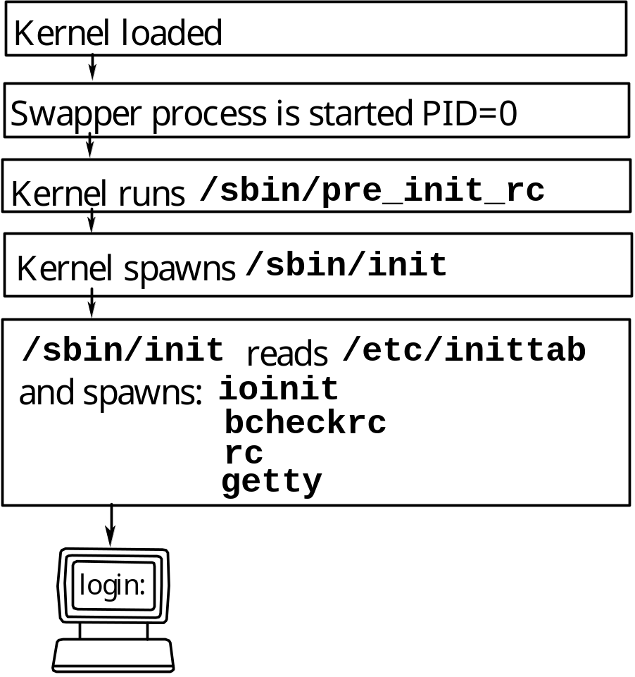
What Happens after the Kernel Is Loaded?
a66988

Slide 12
Run Levels and init
Init starts services in stages (run levels)
Possible run levels = 0, s, 1, 2, 3, 4, 5, 6
Lower run levels = few services available
Higher run levels = more services available
Simplified example:
Run level: Services available:
3 syncer, spooler, CDE
2 syncer, spooler
1 syncer
0
a66989

Slide 13
Changing Run Levels with init
Viewing the current run level
# who -r
. Run-level 3 Dec 1 12:13 3 0 S
previous run level
# times at this level since boot
current run level
when this level was entered
current run level
Changing run levels
# init 4 # moves up to run level 4
# init 2 # moves down to run level 2
# init 3 # moves back up to run level 3
a66990

Slide 14
Configuring init via /etc/inittab
Sample initab file
### change the default run level here
init:3:initdefault:
### pre-configured lines required for boot - don’t change!
ioin::sysinit:/sbin/ioinitrc # scan h/w and create dev files
muxi::sysinit:/sbin/dasetup # initialize console mux
stty::sysinit:/sbin/stty 9600 # set console baud rate, etc.
brcl::bootwait:/sbin/bcheckrc # run fsck on file systems
cprt::bootwait:/sbin/cat /etc/copyright # display copyright
sqnc::wait:/sbin/rc # start add’l daemons and svc’s
### these lines display login prompts
cons:123456:respawn:/usr/sbin/getty console # login prompt on console
t0pl:234:respawn:/usr/sbin/getty -h tty0p1 H # login prompt for tty0p1
t0p2:234:respawn:/usr/sbin/getty -h tty0p2 H # login prompt for tty0p2
(Note: some arguments are truncated from commands to fit on slide.)
a69711

